Slide 1
Budget Buddy
Diego Alvarez COM 437-OL01 Dr. Mancini

Slide 2
Description
The application will be a budgeting application that will allow users to set a budget amount for different categories and keep a running amount at the top of the screen.

Slide 3
Problem Addressing
Current budgeting applications limit the user’s ability to compare how current spending aligns with their end of month budget. Because of unexpected expenses, staying within a budget can sometimes be difficult. Being able to measure the sum of all expenses during the current month will better help users determine if they need to pull back on expenses until the end of the budgeting cycle, or if they can afford to make additional expenses.

Slide 4
Platform
This application was developed using Android Studio API – 25. (Android 7.1.1 – Nougat)

Slide 5
Front/Back end support
This application was created using XML and Java on Android studio. Github was also utilized to track the development process and to track changes throughout the development process.
The platform will allow for future upgrades to application as deemed necessary by the client.

Slide 6

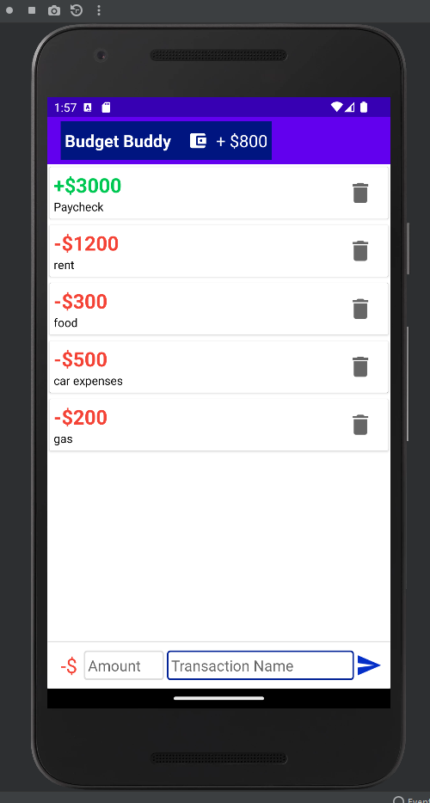
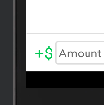
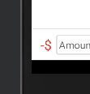
Functionality
A running total will be kept at the top bar.
The application allows users to keep a running tally of their budge by inputting credits and debits to the running tally. In order to add a debit transaction, users click on the green dollar sign at the bottom left of the screen and it will change into a red dollar sign with a subtraction symbol.

Slide 7
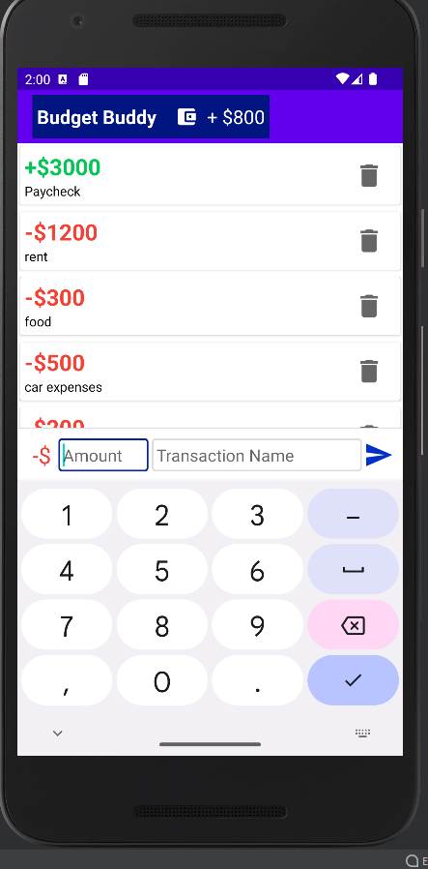
Design
The input window will be determined by either the positive or negative input designation. There will be a window for the dollar amount and another input window for the description of the corresponding transaction.

Slide 8
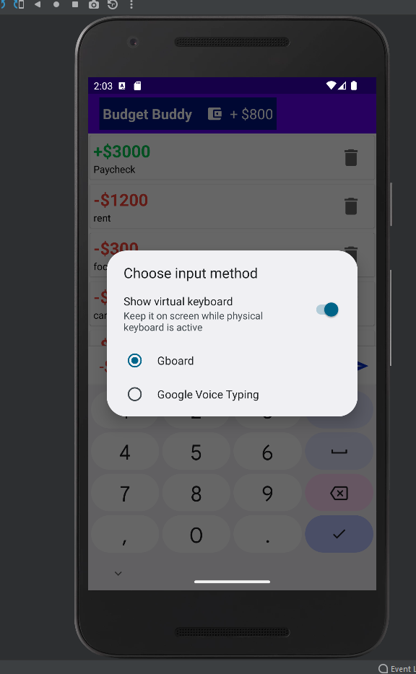
Design (continued)
Google voice capability
The App will have voice typing capability to allow for easy input of amount and transaction description.

Slide 9
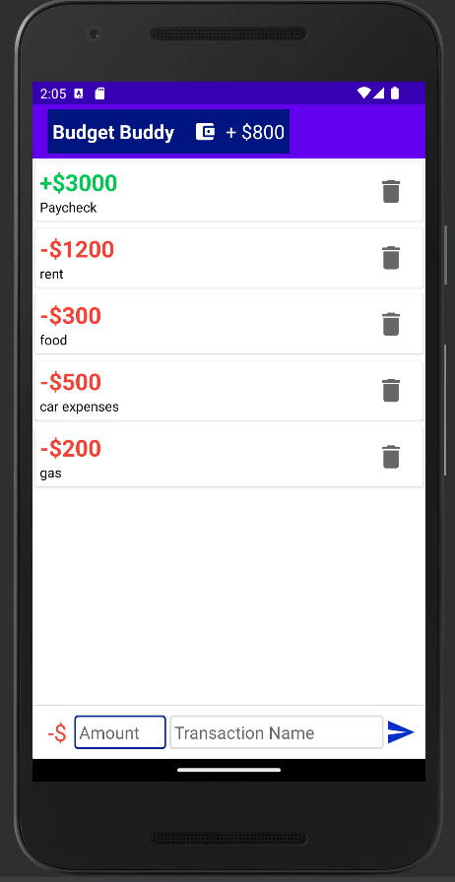
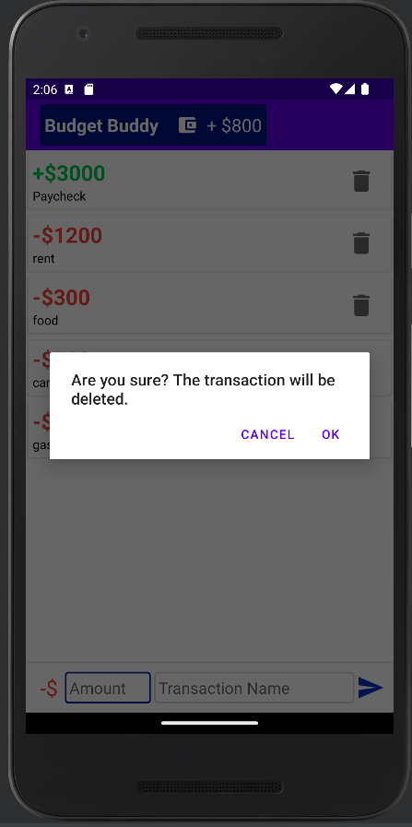
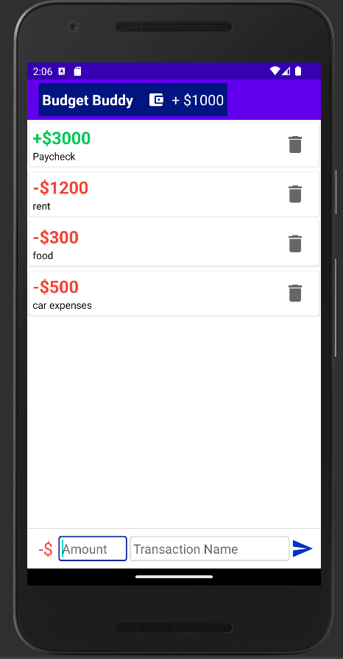
Design (continued)
Once a transaction is removed, the total bar at the top of the screen will be updated accordingly for an accurate budget total. This will allow users to know exactly how much money they have to work with for that specific month.

